Slide 1

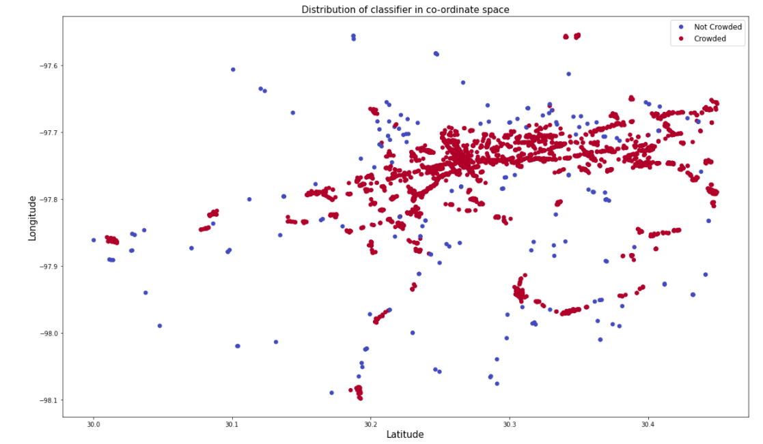
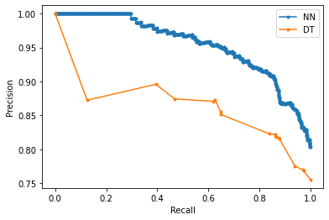
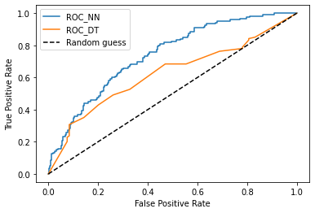

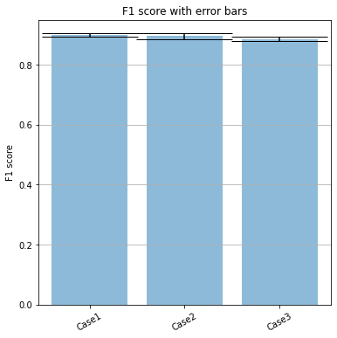
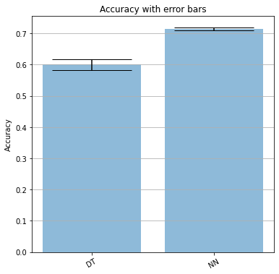
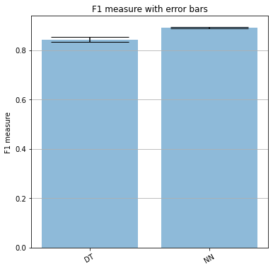
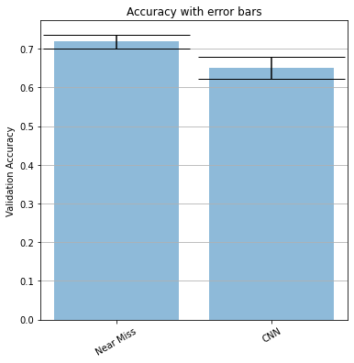
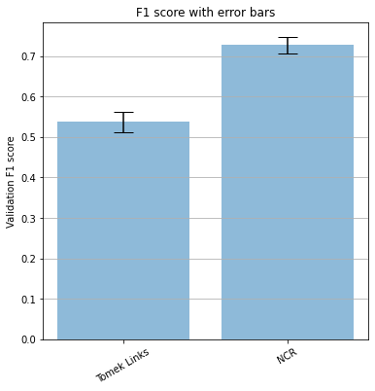
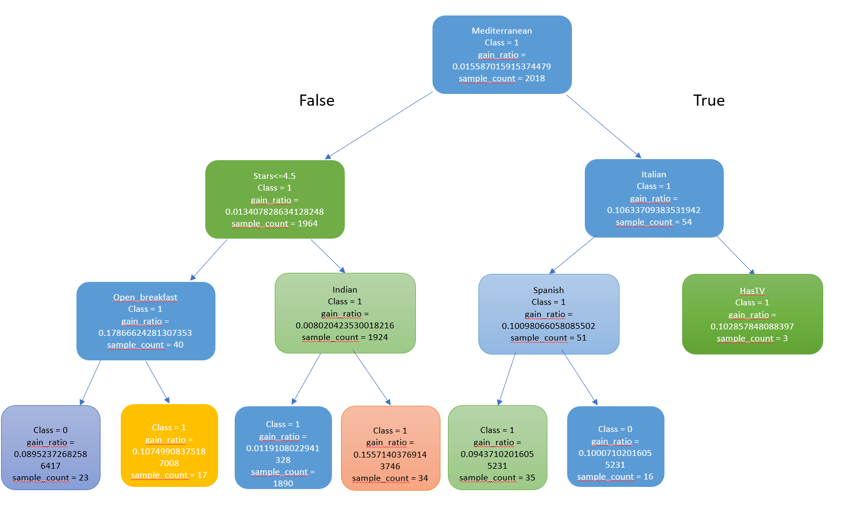
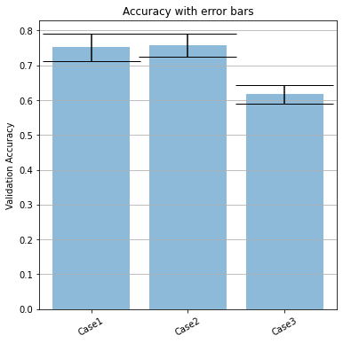
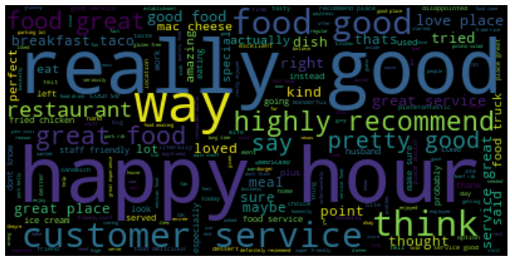
Prediction of Restaurants closure using Yelp Data
Krishna Kabi, Ponmanikandan Velmurugan, Sheenam Gupta
University of California, Riverside
PURPOSE
8. Open hours: open for breakfast/lunch/dinner
9. Attributes: ‘price’ , ‘has_delivery’ , ‘ambience’, ‘hasTV’ etc. One hot encoding and Imputation for missing values was performed.
9. Location of restaurant: Crowded/ Isolated:
i. K-means : results yield were not satisfying
ii. KD-tree : resulted good clusters
10. Part of chain restaurants / Independently owned: TF- IDF
Experiment 2:
For under sampling majority class, we followed 4 approaches to verify which method gave better model performance.
Near miss
Condensed Nearest Neighbor Rule (CNN)
Tomek Links
Neighborhood cleaning Rule (NCR)
Experiment 1 was performed for both Imbalanced and balanced case and experiment 2, is itself a check for balanced case.
FINAL RESULTS
Restaurants need funding and investor needs to make smarter decisions to earn good profit. Predicting restaurant closure would ease the decision-making process.
Yelp dataset provides rich information about restaurants performance, user reviews, and many such features that can be used for prediction.
Imbalanced case:
Decision Tree: Test F1_Score: 0.843 with STD: 0.010
Neural Networks: Validation F1_score: 0.8997 Test F1_Score: 0.89
Near Miss, balanced case:
Decision tree: Test accuracy: 0.610 with STD: 0.017
Neural networks: Validation accuracy: 0.71 Test accuracy: 0.74
OBJECTIVE
EXPERIMENTAL RESULTS
We consider data from 2016-2019 to predict if a restaurants is open in 2016 will it close at the end of 2019. We did not consider data after 2019 due to COVID-19 as there would sudden spike in business closure, which can be considered as an anomaly.
Experiment 1: Imbalanced case
For imbalanced case, we can confirm dropping one feature over other did not improve F1 score significantly. And there was no statistical significance that can be inferred by plotting the F-Scores in an error plot.
EVALUATION METRICS
PRE-PROCESSING
Since, rate of restaurants closure is usually less than restaurants remaining in business, the dataset is imbalance in nature.
We use two methods to evaluate model performance:
Imbalanced dataset: F1 score, precision and recall curve
Under sampling majority class and using accuracy as metric.
Pre-processing required considerable efforts as many features had to be generated.
Used two dataset: business and reviews
Used restaurants only in Texas: second highest restaurants count
Features generation:
Target variable (is_open): Not readily available. The target feature ‘is_open’ had updated list till 2021 and we wanted closure that happened by end of 2019.
Reviews less than threshold of 10 in a year marked as tentative else open for that year.
Any restaurants having no review following year marked as closed
Tentative restaurants were further processed by taking last 5 reviews of it and searching for phrases like ‘shut down, not open’ etc.
Yet was challenging, manual intervention helped.
Age/ Years of operation: If last review before October 2016, removed those business, if last review in 2017, age = 2017-2016.
Cuisines: American/ Italian/ Mexican etc
Review count: total no. of reviews between 2016-2019 from review dataset
Positive: >3, Negative: < 3, Neutral reviews: ==3
Text feature: Bi-gram features: ‘bi_good_food’, ‘bi_good_loc’, ‘bi_bad_food’.
MODELS
We implemented two models:
Decision Tree: Training : 80, Test: 20, Splitting criteria: Entropy
Maximize Information Gain at Each level
ii. Minimize Entropy or Split impurity
iii. C4.5 Algorithm is used, tested with dynamic tree
Neural Network: Training : 80, Test: 20, Training : 5-fold cross validation.
i. Neurons: 200
ii. Layer: 1
iii. Learning rate: 0.00001
iv. Optimizer: Adam
v. Batch size: 64
Experiment 2: Balanced case
Near miss and CNN gave low accuracy than Tomek links and NCRule, and no conclusive evidence can be found for Tomek links and NCRule method to confirm which method performed better.
NCRule was finally chosen as it gave good representation of majority classes versus minority class.
CONCLUSION
Experiment 1: Balanced Case
We can conclude from Case 3, that the numerical features does increase model’s accuracy as seen from case 1 and 2 . But we cannot say same things for Case 1 and 2 as removing one features over another did not improve model’s accuracy significantly.
So, Case 1 was used to train the final model.
We conclude that Neural networks works better than decision trees because of its capability of non-linear features too. However, for our project Neural networks being complex for simple task, It provided promising results as expected. However, due to computational cost of Decision Tress we were not able to capture continuous features in Decision Trees. However, further exploring the model’s data structure to improve the construction and prediction can ensure better evaluation metrics.
TRAINING EXPERIMENTS
Years_of operation / age column: dropped due to data leakage
Corr-related features were dropped as per corr-relation plot.
Pos, neg, neutral features showed high co-relation with total count.
Although, they were dropped, we initially assumed this feature would be critical to determine restaurants closure.
To confirm that below 3 cases were considered:
Experiment 1:
Case 1: Keep total_review count feature and drop pos, neg and neutral and check model performance.
Case 2: Keep pos, neg, neutral feature and drop total review count and check model performance.
Case 3. Keep all categorical columns only ( to check if numerical columns had any impact on model performance)
FUTURE SCOPE
Using both oversampling and under-sampling method and use accuracy to evaluate model performance.
Instead of using data for one state, getting more data for entire US would increase more training data and can help in improving model performance.

